Slide 1

DHCP
Presented by:
Soumya Gupta
Emp ID - 152915

Slide 2
Overview
What is DHCP ?
Need for DHCP
Advantages of DHCP
Working of DHCP
Mechanism to assign IP address in DHCP

Slide 3
DHCP
It stands for Dynamic Host Configuration Protocol.
DHCP automatically assign the IP address to the computer.

Slide 4
Need for DHCP
Allocation of unique IP address to large number of devices.
Manually tracking and updating records, easily result in errors and inconsistencies.
Assigning IP address manually is time consuming.
Non availability of real time data in manual method.
Notes:
Usar para separador de capitulos . Seria bom ter esta versao em vermelho e verde tb..

Slide 5

Advantages of DHCP
It minimizes administrative burden.
There is no chance to conflict IP addresses.
Reduces the amount of time you spend configuring computers on your network.
No need to keep records of assigned IP addresses.
Notes:
O Logo de espadas deve ter mais espaço das pontas abaixo. Sugerir outros tipos de imagens/ telefone, fones.

Slide 6

How DHCP Works ?

Slide 7
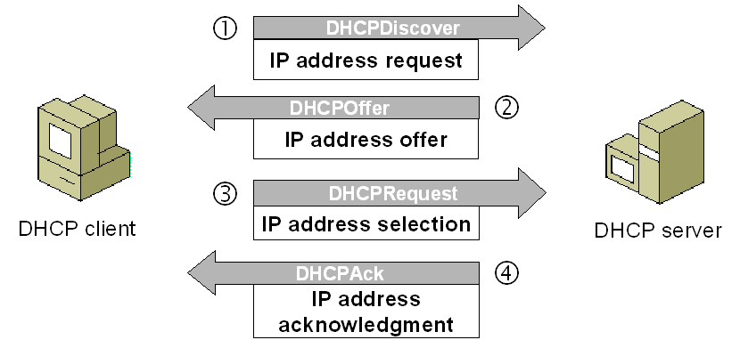
DHCP works on DORA process :
Notes:
Fixar a posicao do titulo – sempre do lado esquerdo.
Sempre que tiver muito texto o coluna deve sempre ser “ narrowed” , se nao fica dificil de ler. Colocar paragrafos no texto.
Linha vertical deve ser mais fina e as pontas NUNCA devem ser arredondadas.

Slide 8
Mechanism to assign IP address
There are 3 mechanism to assign IP address in DHCP :
Automatic allocation : DHCP assigns permanent IP address to a client.
Dynamic allocation : DHCP assigns IP address to a client for a limited period of time.
Manual allocation : A client’s IP address is assigned by network administrator and DHCP is simply used to convey IP address to the client.
Notes:
Fixar a posicao do titulo – sempre do lado esquerdo.
Sempre que tiver muito texto o coluna deve sempre ser “ narrowed” , se nao fica dificil de ler. Colocar paragrafos no texto.
Linha vertical deve ser mais fina e as pontas NUNCA devem ser arredondadas.

Slide 9

Email Services

Slide 10
Overview
What is email ?
Components of email
Email Protocols
Components of Mail Server
Working of email

Slide 11

Email
Short form of electronic
mail.
Send and receive messages
over the internet

Slide 12
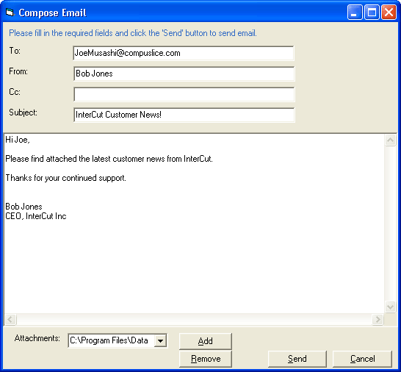
Components of Email

Slide 13
Email Protocols
Protocols used for email are :
Simple Mail Transfer Protocol
SMTP
Post Office Protocol
POP3
Internet Mail Access Protocol
IMAP4

Slide 14
SMTP –
SMTP is used for sending emails.
SMTP is used in combination with either POP3 or IMAP4.
POP3 –
POP3 is used to receive emails from a remote server to a local email client.
POP3 allows you to download emails on your local computer and read them even when you are offline.
Messages are downloaded locally and removed from the email server.
IMAP4 –
IMAP is a mail protocol used for accessing email on a remote web server from a local client.
Keep the original e-mail stored on the mail server

Slide 15
Components of Mail Server
A mail server consists of many
components that provide a specific
function.
Mail Transfer Agent (MTA)
Mail User Agent (MUA)
Mail Delivery Agent (MDA)

Slide 16
Mail Transfer Agent - MTA transports email between hosts using SMTP.
Examples of MTA : Postfix and Sendmail.
Mail Delivery Agent - MDA is invoked by the MTA to deliver
incoming email in the proper user’s mailbox.
Example of MDA : Procmail and mail.
Mail User Agent - MUA is a program that allows you to receive
and send e-mails.
Examples of MUA : Thunderbird and Outlook.

Slide 17
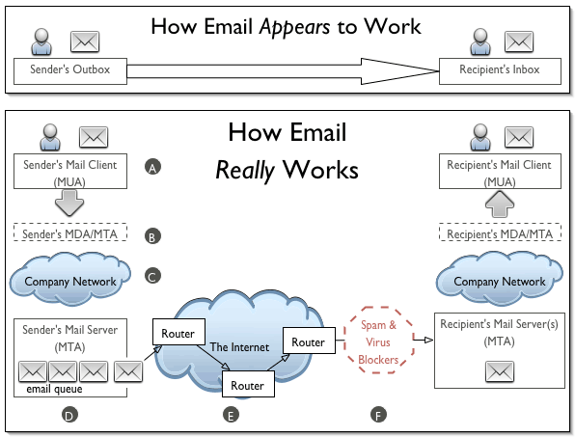
How Email works ?

Slide 18


